Slide 1

Deepfake Video Detection
Group Members:
Muneeb Raza(17P-6149)
Saood Ur Rahman(17P-6092)
Supervisor: Ms. Safia Fatima
1

Slide 2
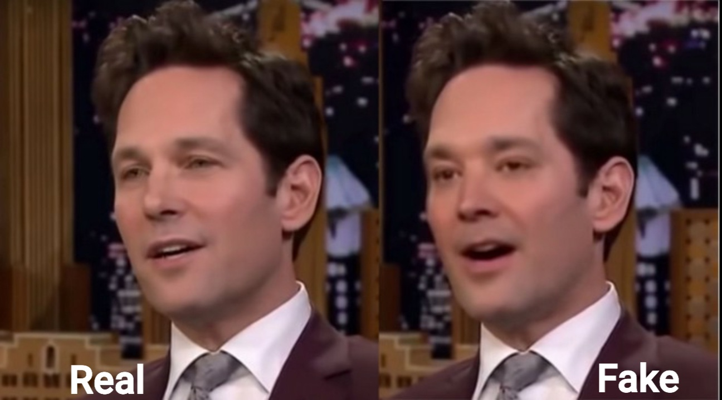
Introduction
What is a Deepfake?
A video manipulation technique which generates and replaces faces
Utilizes neural network
First deepfake video emerged in 2017
Positive Use:
Updating episodes of movies without reshooting them
where is deepfake today:
DeepNude Software
Chinese app Zao
Etc.
2

Slide 3
Literature Review
Research Paper | Model | DataSet
Deepfake video Detection Using RNN[1] | Conv-LSTM | HOHA
DeepfakesON-Phys: Deepfakes Detection based on Heart Rate Estimation[2] | Convolution Attention Network | Celeb-DF v2
Exposing Deep Fakes Using Inconsistent Head Poses[3] | SVM | UADFV
Video Face Manipulation Detection Through Ensemble of CNNs[4] | CNN | FF++ And DFDC
CNN-generated images are surprisingly easy to spot… for now[5] | Generative Adversarial Network | LSUN
2

Slide 4
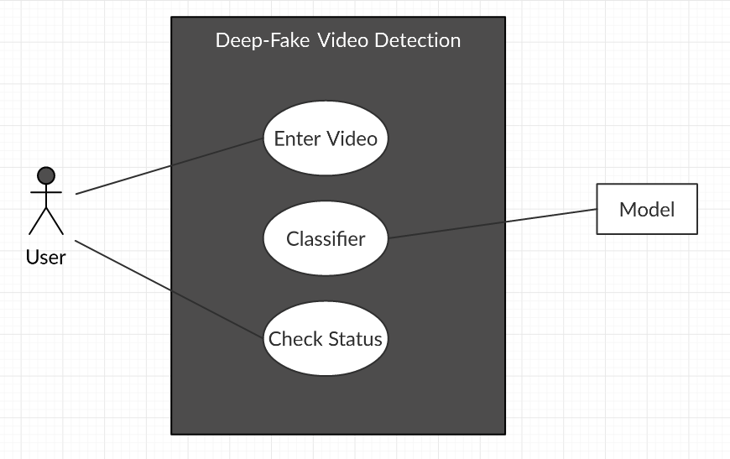
Use Case Diagram
2

Slide 5
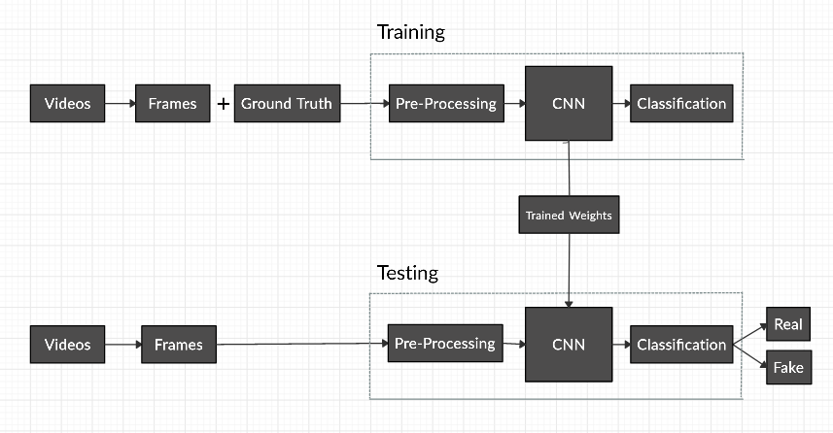
Architecture Diagram
2

Slide 6
How Fake Images are Generated ?
Auto encoders
Generative Adversarial Network(GAN)
6

Slide 7
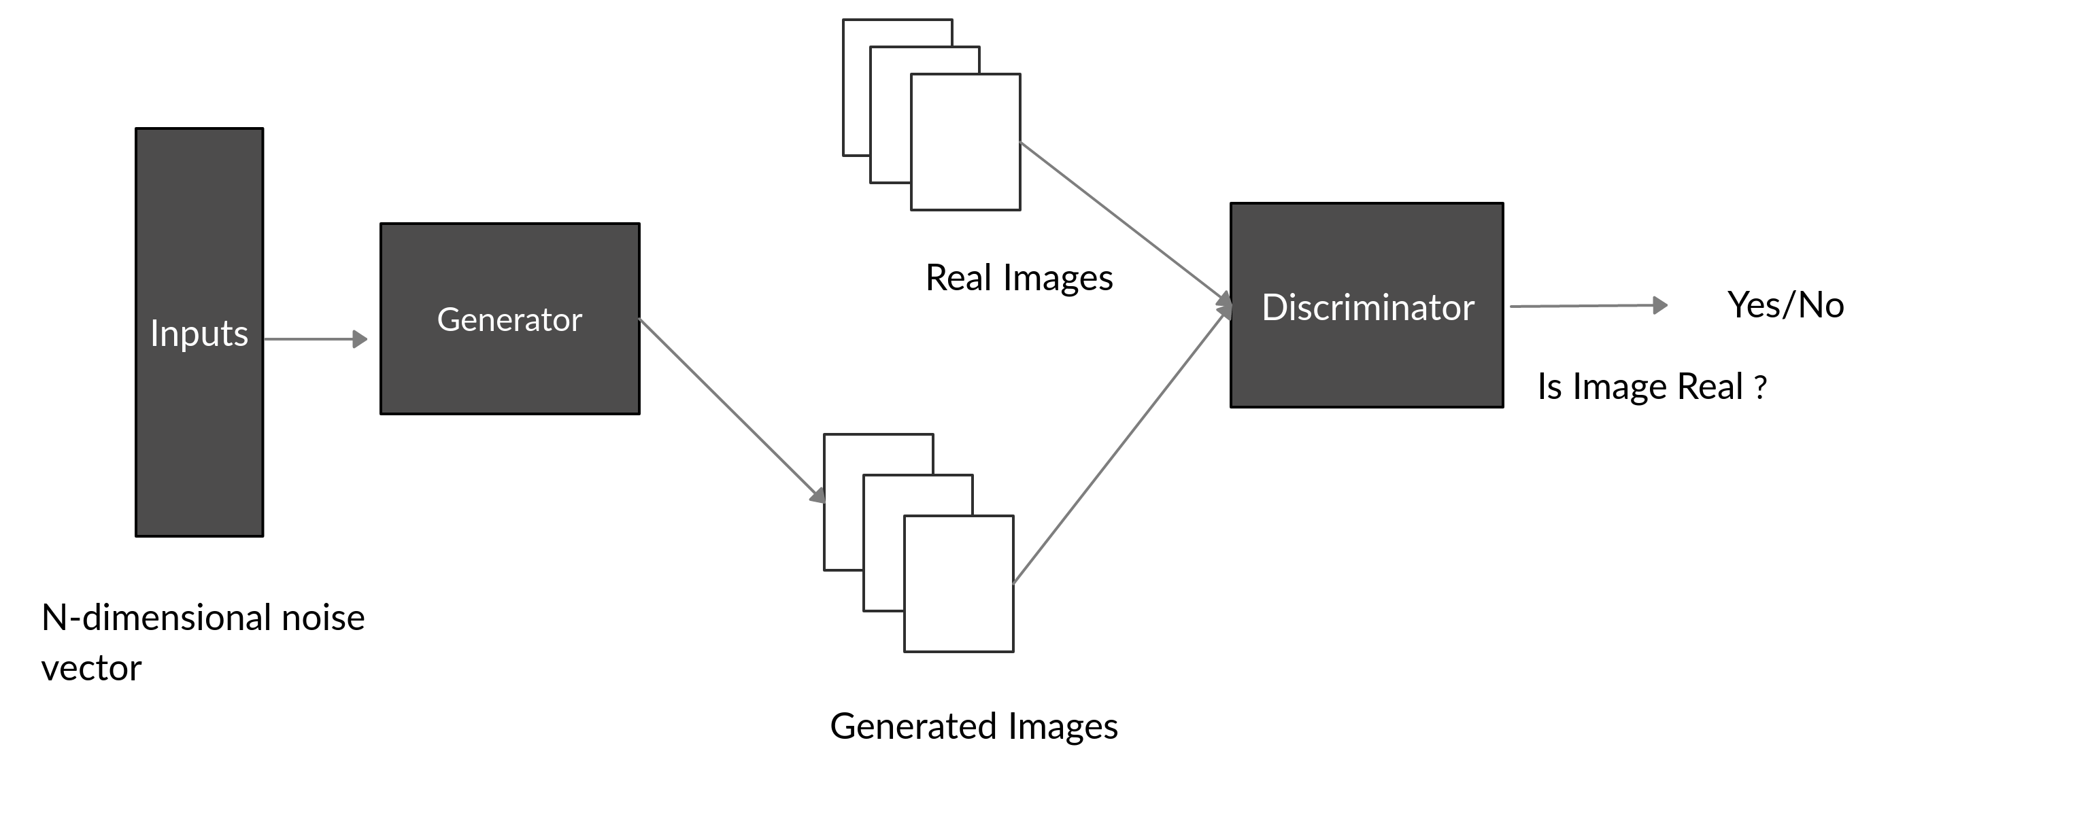
Architecture of GAN
6

Slide 8
Future plan
FYP -1
Image generation
Model implement
FYP-2
Training and tuning
Application
Documentation
6

Slide 9
References
[1] Güera, David, and Edward J. Delp,"Deepfake video detection using recurrent neural networks. IEEE International Conference on Advanced Video and Signal Based Surveillance",2018.​
[2] Hernandez-Ortega, Javier, et al.,"DeepFakesON-Phys: DeepFakes Detection based on Heart Rate Estimation",2020.​
[3] Yang, X., Li, Y., & Lyu, S.,"Exposing Deep Fakes Using Inconsistent Head Poses. ICASSP IEEE International Conference on Acoustics Speech and Signal Processing",2019. ​
[4] Bonettini, Nicolò, et al., "Video Face Manipulation Detection Through Ensemble of CNNs",2020.​
[5] Wang, S.-Y., Wang, O., Zhang, R., Owens, A., & Efros, A. A., "CNN-Generated Images Are Surprisingly Easy to Spot… for Now. IEEE/CVF Conference on Computer Vision and Pattern Recognition",2020.​
Future
6

Slide 10
Thank You
10

